Slide 1

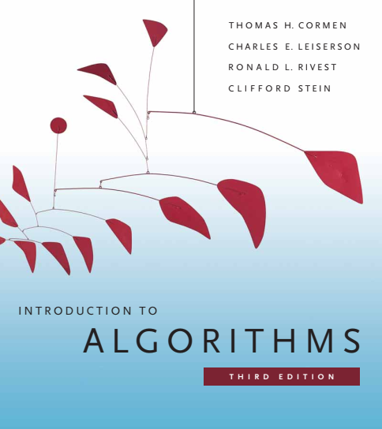
Design and Analysis of Algorithms
Dr. Sajid Iqbal
sajidiqbal.pk@gmail.com
Reference Book
Introduction to Algorithms 3rd Edition By Thomas H. Cormen et. al.
https://mitpress.mit.edu/books/introduction-algorithms-third-edition
COMEDXD

Slide 2
Bucket Sort
A Non-Comparison sort

Slide 3
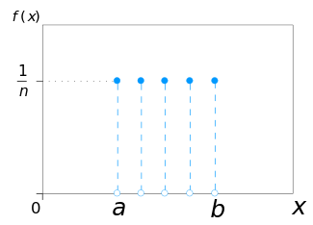

Introduction
Uniform Distribution: Divide the interval 0-1 into n equal sized subintervals
$\frac{0+1}{n}$
In Bucket sort inputs are drawn by a random process from a uniform distribution over interval 0-1 and has an average-case running time of O(n).
Bucket Sort divides the inputs into sub-intervals (groups) known as buckets
It sorts the numbers in each bucket and then places the elements in order bucket by bucket

Slide 4
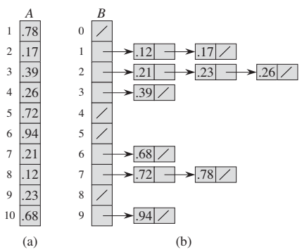


Bucket Sort
Assume that input is n-element array A such that $0≤A[i]<1$
$B[0,…,n−1]$is an auxiliary array of linked lists (buckets)
The operation of BUCKET-SORT for n = 10.
The input array $A[1 : : 10].$
The array $B[0 : : 9]$of sorted lists (buckets).
Bucket $i$ holds values in the half-open interval
$[i/10, (i + 1)/10].$The sorted output consists of a concatenation in order of the lists $B[0], B[1],…,B[9].$
$$\left[\frac{i}{10},\frac{i + 1}{10}\right]=[0−0.1,0.1−0.2,….,0.9−1.0]$$

Slide 5
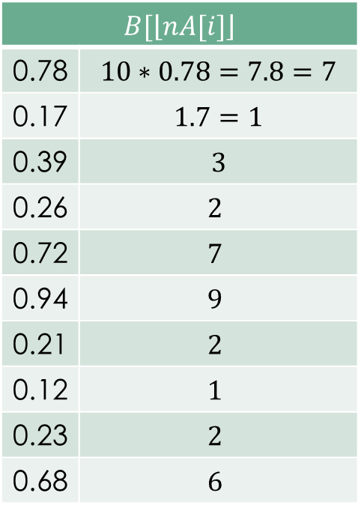
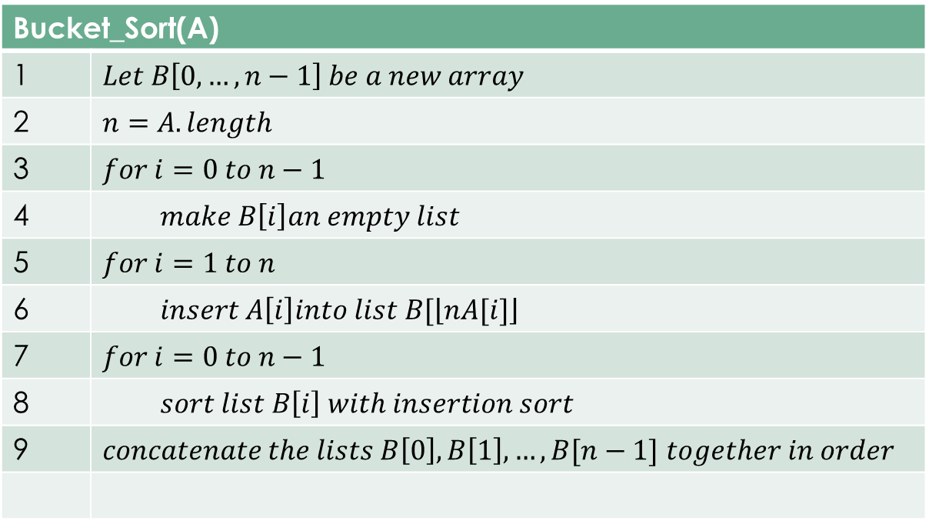
Bucket Sort
Bucket_Sort(A)
1 | $$Let B\left[0,…,n−1\right] be a new array$$
2 | $$n=A.length$$
3 | $$for i=0 to n−1$$
4 | $$make B\left[i\right]an empty list$$
5 | $$for i=1 to n$$
6 | $$insert A\left[i\right]into list B[\left\lfloor nA[i]\right\rfloor$$
7 | $$for i=0 to n−1$$
8 | $$sort list B\left[i\right] with insertion sort$$
9 | $concatenate the lists B\left[0\right], B\left[1\right],…,B[n−1]$ $together in order$
$$B[\left\lfloor nA[i]\right\rfloor$$
0.78 | $$10∗0.78=7.8=7$$
0.17 | $$1.7=1$$
0.39 | $$3$$
0.26 | $$2$$
0.72 | $$7$$
0.94 | $$9$$
0.21 | $$2$$
0.12 | $$1$$
0.23 | $$2$$
0.68 | $$6$$

Slide 6
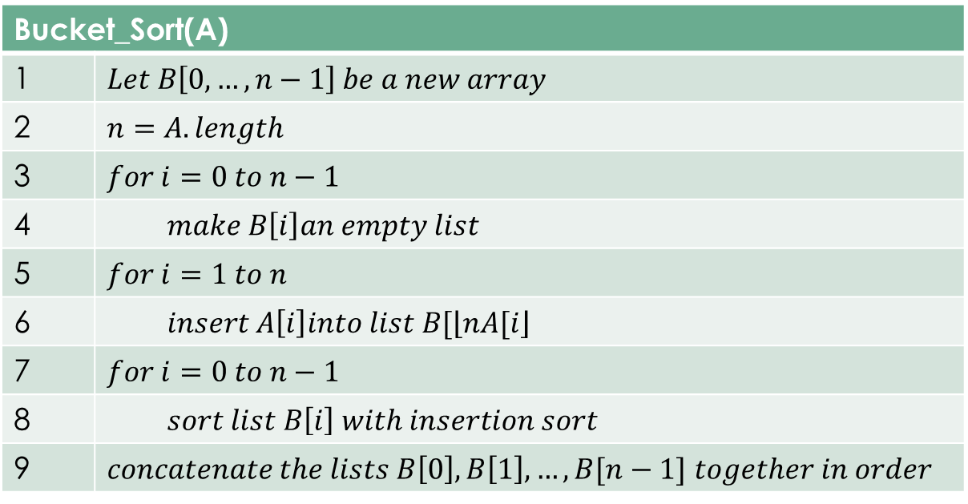

Working of Bucket Sort
Consider two elements A[i] and A[j] and $A[i]≤A[j]$.
Since $nA[i]≤nA[j]$,
If $A\left[i\right]=A\left[j\right], line 7−8$puts then in proper order
If $A\left[i\right]<A[j]$, line 9 puts them in proper order

Slide 7

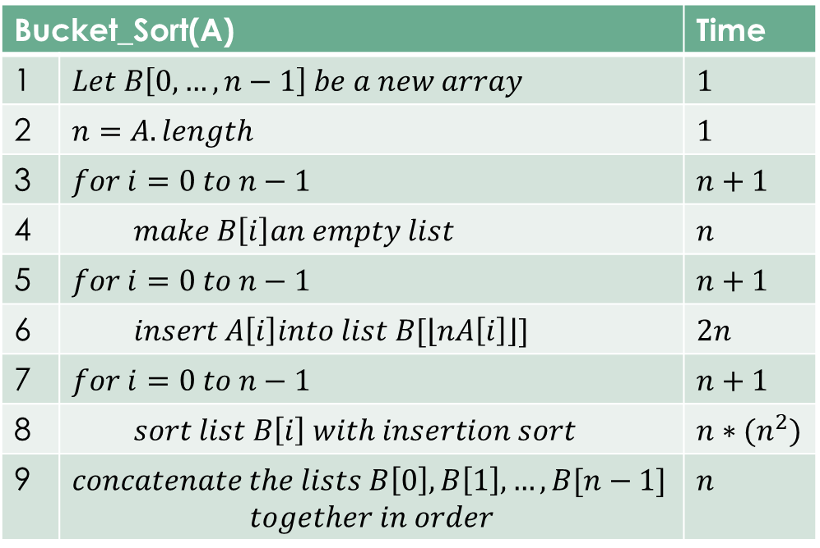
Algorithm Time Complexity
Bucket_Sort(A) |  | Time
1 | $$Let B\left[0,…,n−1\right] be a new array$$ | $$1$$
2 | $$n=A.length$$ | $$1$$
3 | $$for i=0 to n−1$$ | $$n+1$$
4 | $$make B\left[i\right]an empty list$$ | $$n$$
5 | $$for i=0 to n−1$$ | $$n+1$$
6 | $$insert A\left[i\right]into list B[\left\lfloor nA\left[i\right]\right\rfloor ]$$ | $$2n$$
7 | $$for i=0 to n−1$$ | $$n+1$$
8 | $$sort list B\left[i\right] with insertion sort$$ | $$n∗(n^{2})$$
9 | $concatenate the lists B\left[0\right], B\left[1\right],…,B[n−1]$ $$together in order$$ | $$n$$
$f\left(n\right)=1+1+\left(n+1\right)+n+\left(n+1\right)+2n+\left(n+1\right)+\sum_{i=0}^{n−1}{O\left(n_{i}^{2}\right)+n}$
$f\left(n\right)=5+7n+$ $\sum_{i=0}^{n−1}{O\left(n_{i}^{2}\right)}$
Worse case running time
$f\left(n\right)=\sum_{i=0}^{n−1}{O\left(n_{i}^{2}\right)}+7n+5$
$f\left(n\right)≤\sum_{i=0}^{n−1}{O\left(n_{i}^{2}\right)}+7n^{2}+5n^{2}$
Each bucket has different size, let we assume that all have same size
$f\left(n\right)≤nO(n_{i}^{2})+7n^{2}+5n^{2}$
$f\left(n\right)≤nO(n^{2})+7n^{2}+5n^{2}$
$f\left(n\right)≤O(n^{3})+12n^{2}$
$f\left(n\right)=O(n^{3})$

Slide 8

Average Case Analysis
Each bucket size may differ, we compute on the average bucket size
$T\left(n\right)=\sum_{i=0}^{n−1}{O\left(n_{i}^{2}\right)}+7n+5$ $=\sum_{i=0}^{n−1}{O\left(n_{i}^{2}\right)}+θ(n)$
$E\left[T\left(n\right)\right]=E[θ\left(n\right)+$ $\sum_{i=0}^{n−1}{O\left(n_{i}^{2}\right)}$]
= $θ\left(n\right)+$ $\sum_{i=0}^{n−1}{E[O\left(n_{i}^{2}\right)]}$
= $θ\left(n\right)+$ $\sum_{i=0}^{n−1}{O(E\left[n_{i}^{2}\right])}$
Let we define indicator random variable $X_{ij}=I\{A\left[j\right]$ falls in bucket i$\}$
$n_{i}=\sum_{j=1}^{n}{X_{ij}}$
$n_{i}^{2}={\left(\sum_{j=1}^{n}{X_{ij}}\right)}^{2}$ by taking square of both sides

Slide 9

$n_{i}^{2}={\left(\sum_{j=1}^{n}{X_{ij}}\right)}^{2}$
$E\left[n_{i}^{2}\right]=E\left[{\left(\sum_{j=1}^{n}{X_{ij}}\right)}^{2}\right]$
=$E[\sum_{j}^{n}{\sum_{k}^{n}{X_{ij}X_{ik}}}]$
$=E[\sum_{j=1}^{n}{X_{ij}^{2}}+\sum_{j}^{n}{\sum_{k}^{n}{X_{ij}}}X_{ik}]$ $∴blue term for k=j and$for second term $k≠j$
$E[\sum_{j=1}^{n}{X_{ij}^{2}}]+\sum_{j}^{n}{\sum_{k}^{n}{E[X_{ij}}}X_{ik}]$

Slide 10


$$E[\sum_{j=1}^{n}{X_{ij}^{2}}]+\sum_{j}^{n}{\sum_{k}^{n}{E[X_{ij}}}X_{ik}]$$
We evaluate the two summations separately.
Indicator random variable $X_{ij}=1$with probability $\frac{1}{n}$ and $0$ otherwise
$E\left[X_{ij}^{2}\right]=\frac{1}{n}.1^{2}+\left(1−\frac{1}{n}\right).0^{2}=\frac{1}{n}$ $∴E\left[X\right]=p\left(x\right).x+\left(1−p\left(x\right)\right).y$
When $k≠j, variables X_{ij} and X_{ik}$ are independent hence
$E\left[X_{ij}X_{ik}\right]=E\left[X_{ij}\right]E\left[X_{ik}\right]=\frac{1}{n}.\frac{1}{n}=\frac{1}{n^{2}}$
Now adding both
$E[\sum_{j=1}^{n}{X_{ij}^{2}}]+\sum_{j}^{n}{\sum_{k}^{n}{E[X_{ij}}}X_{ik}]$
$=\sum_{j=1}^{n}{\frac{1}{n}}+\sum_{j}^{n}{\sum_{k}^{n}{\frac{1}{n^{2}}}}]$ $=n\left(\frac{1}{n}\right)+n\left(n−1\right)\left(\frac{1}{n^{2}}\right)=1+\frac{n−1}{n}=1+1−\frac{1}{n}=2−\frac{1}{n}$
$Hence E\left[n_{i}^{2}\right]=2−\frac{1}{n}$

Slide 11

$T\left(n\right)=θ\left(n\right)+$ $\sum_{i=0}^{n−1}{O(E\left[n_{i}^{2}\right])}$
$E[T\left(n\right)]=E[θ\left(n\right)+$ $\sum_{i=0}^{n−1}{O(E\left[n_{i}^{2}\right])}]$
$E[T\left(n\right)]=θ\left(n\right)+$ $n.O\left(2−\frac{1}{n}\right)$
$=$ $θ\left(n\right)+$ $O\left(2n−\frac{n}{n}\right)$
$=θ\left(n\right)+$ $O\left(2n−1\right)$
= $θ\left(n\right)+O\left(n\right)=O(n)$

Slide 12

Thanks for watching
Dr. Sajid Iqbal
Assistant Professor
Department of Computer Science
Bahauddin Zakariya University, Multan
sajidiqbal.pk@gmail.com
YouTube Channel: COMEDXD
Allah Hafiz

Slide 13
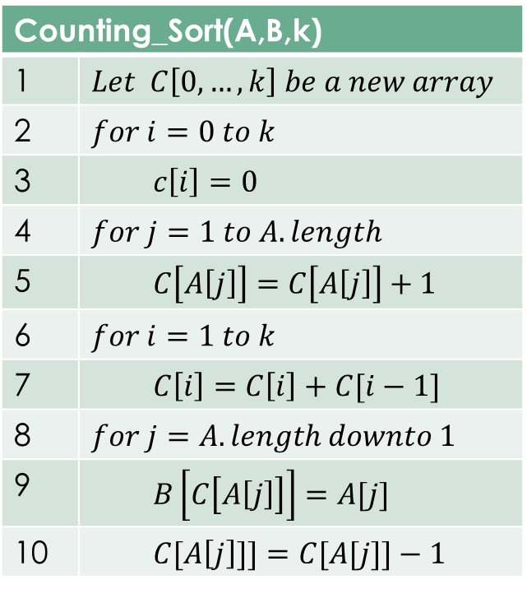
Counting_Sort(A,B,k)
1 | $$Let C\left[0,…,k\right] be a new array$$
2 | $$for i=0 to k$$
3 | $$c\left[i\right]=0$$
4 | $$for j=1 to A.length$$
5 | $$C\left[A\left[j\right]\right]=C\left[A\left[j\right]\right]+1$$
6 | $$for i=1 to k$$
7 | $$C\left[i\right]=C\left[i\right]+C[i−1]$$
8 | $$for j=A.length downto 1$$
9 | $$B\left[C\left[A\left[j\right]\right]\right]=A[j]$$
10 | $$C[A\left[j\right]]]=C[A[j]]−1$$

